Slide 1

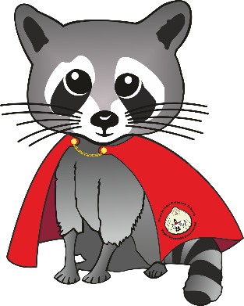

Sealions
Penclawdd Primary School : Spring Term 2026
Shwmae Sealions!
Happy New Year and welcome back to school! We hope you had a wonderful break and are ready for an exciting new term ahead. This half term, our new topic Splendid Skies will take the children on a journey beyond our world and into space. We will be looking up at the sky to explore the Sun, Moon, stars, and planets, sparking curiosity and a sense of wonder about the universe around us.
As we return to school routines, we will be supporting the children to feel settled, confident, and eager to learn. Through stories, creative activities, investigations, and imaginative play, the children will begin to ask big questions about space, astronauts, and what lies beyond Earth. This topic will encourage curiosity, creativity, and awe, helping the children to see that learning really has no limits. We’re so excited to begin this out-of-this-world adventure together!
Topic Overview
Splendid Skies
This term, our project is all about Splendid Skies— a topic chosen and driven by the curiosity and imagination of our learners. We will be looking up to the sky and beyond, exploring space, the Moon, stars, planets, and astronauts — and following the children’s interests as the learning takes shape.
Our literature book ‘Man on the Moon’ will inspire rich discussions, creative thinking, and imaginative storytelling as we explore what life might be like in space and whether there is more to the Moon than meets the eye. We hope to spend lots of time outdoors observing the sky, noticing changes between day and night, and using our natural environment to spark wonder and questions.
Along the way, we will be asking big questions like:
💬 Why do we need astronauts?
💬 What is new in terms of space developments?
💬 Why should we look after Planet Earth?
Engage
Children will participate in a Lunar Camp afternoon They will experience astronaut training, build their own constellations and rockets in the classroom, and take part in a rocket launch simulation. This hands-on, creative event will help the children explore space, work together as a team, and spark their imagination for the rest of the topic.
In February, we are going to have an interactive space experience to develop our topic ‘Space’ inside a virtual dome.
Express – Sharing the Learning
Wednesday 18th March – 2:30pm to 3pm
A happy face, a learning place , a growing space

Slide 2



In French, we will be learning to recognise, say, read, and write numbers from 10 to 20. We will also practise simple greetings, basic classroom words, and short phrases, helping children build confidence in speaking and listening in French.
Sealions
Penclawdd Primary School : Spring Term 2026
Our literacy this term will be closely linked to our Splendid Skies topic. Through carefully chosen texts, the children will explore themes of space, imagination and exploring.
We will:
Read and enjoy ‘Man on the Moon’, using it to spark discussion, predict events, and explore characters, settings, and feelings.
Write simple narratives, diary entries, and captions linked to Bob’s adventures on the Moon.
Create fact files and labels about the Moon, space, planets, and astronauts.
Practice instructional writing, such as How to become an astronaut or How to get to the Moon.
Take part in oral storytelling and role play, imagining what we might see or do if we travelled into space.
Use speech bubbles and speech marks to indicate what we think characters are saying.
Create poems, adverts and book reviews.
Enhanced spelling activities with a key focus on phonics and spelling rules.
Weekly SPaG lessons focusing on grammar, punctuation and spelling.
Welsh and French
In Welsh, Sealions practice their Welsh through daily slot Drillio sessions, which allows them to practice patterns and phrases. Our daily Helpwr Heddiw takes part in building speaking and listening skills. Alongside this, they will continue with Tric a Chlic to strengthen early reading skills in Welsh, and use Fa La La songs to make learning fun and musical. In French, we will be learning to recognise, say, read and write numbers from 10-20. We will also practice simple greetings, basic classroom words and short phrases, helping children to build confidence.
Our January Right of the Month is:
Article 29 : To be the best that you can be!
A happy face, a learning place , a growing space

Slide 3
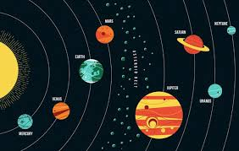
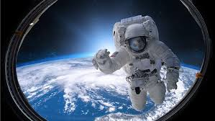
Sealions
Penclawdd Primary School : Spring Term 2026
Mathematics and Numeracy
This term in maths, Year 1 and Year 2 will continue to develop strong number skills using the White Rose Maths approach, with learning that is practical, visual, and engaging.
Year 1 will focus on place value within 20 and beyond, alongside addition and subtraction using practical resources. They will also explore measures and begin to recognise and describe 2D and 3D shapes.
Year 2 will extend their understanding of place value within 100, building confidence with addition and subtraction and beginning work on money, multiplication, and division. They will continue exploring 2D and 3D shapes and applying their learning to real-life problems.
Throughout the term, children will take part in hands-on activities that encourage reasoning, problem-solving, and enjoyment of maths.
Science and Technology
In science this term, the children will be exploring Humans and Animals, learning about what humans need to stay healthy, including the importance of a balanced diet, and comparing this with the needs of other animals. Linking to our Splendid Skies topic, the children will also learn about forces, including gravity and air resistance, and how these affect movement on Earth and in space. They will begin to explore simple circuits and develop early coding skills, helping them to understand how technology works in the world around them. We will also apply our learning about the planets and space in a wider scientific context.
Digital Learning
The children will continue to develop their digital skills through activities that build computational thinking and confidence with technology. They will create and interpret pictograms, use GarageBand to compose music, programme characters to move across different terrains, and explore tools such as NASA websites and Google Earth. They will also practise sending emails and continue to learn how to stay safe online, understanding how to use technology responsibly and sensibly.
.
A happy face, a learning place , a growing space

Slide 4
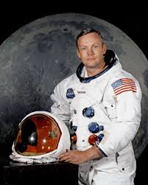
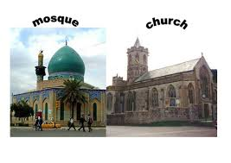
Sealions
Penclawdd Primary School : Spring Term 2026
Humanities
This term, the children will explore the wonders of space in our Splendid Skies project. They will learn what it is like to live and work in space, discovering how astronauts eat, sleep, and float. The children will create fact files about famous astronauts, such as Yuri Gagarin, Neil Armstrong, and Christina Koch, learning about their missions and achievements.
They will also explore how space helps us look after Earth. Using satellites and images from space, they will investigate changes in forests, oceans, and ice, helping them understand climate change and why it is important to care for our planet.
RVE
Alongside this, in Religious Values and Ethics (RVE), we are learning about special religious places in Swansea, including churches, mosques and the synagogue. We will explore what happens in these holy buildings and why religions have special places for worship. What difference do these buildings make to the people who worship there, and how to churches and mosques help people feel a sense of belonging in Swansea?
A happy face, a learning place , a growing space

Slide 5
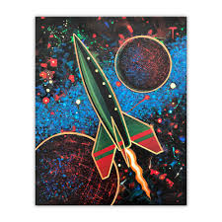
Sealions
Penclawdd Primary School : Spring Term 2026
Expressive Arts
This term, the children will use art, drama, music, and outdoor play to bring our Splendid Skies project to life. In art, they will study the work of Peter Thorpe, a famous space artist, and use his bold, colourful style to create their own rockets, planets, and space scenes. They will also experiment with mixed media to produce imaginative galaxies and planets.
In music, the children will explore Space Sounds, using their voices and instruments to create sounds inspired by rockets, satellites, and floating in space. They will learn an alien dance to space music, moving creatively like creatures from other planets.
In drama and outdoor learning, the children will role play as astronauts, exploring life in a spaceship or on a new planet. They will build space buggies and spaceships outdoors and create imaginative space terrain, combining teamwork, creativity, and movement to bring space adventures to life.
Health and Well-Being
This term, we will be focusing on helping the children to build confidence, resilience, and positive relationships. Through our Splendid Skies project, they will learn about teamwork by imagining life as astronauts and mission control, thinking about how people must work together in space and how we can support one another in school and in our community today.
The children will take part in discussions about kindness, belonging, and helping others, as well as reflecting on what makes them feel happy, safe, and ready for new challenges. They will also learn about healthy eating and balanced diets, thinking about what astronauts need to stay strong and healthy in space.
In PE, the children will continue to develop coordination, balance, and teamwork through fun games, outdoor challenges, and space-themed dance sequences, moving creatively like astronauts or aliens. They will enjoy being active and healthy while practicing teamwork and building confidence. Our aim is to help every child feel secure, valued, and ready to reach for the stars with a positive mindset.
The fruit trolley is fully stocked and ready for customers — 30p per day.
Healthy School Reminder 💧
As part of our commitment to being a healthy school, we kindly ask that children only bring water to drink during the school day. This helps promote good habits, supports concentration, and encourages healthy choices
A happy face, a learning place , a growing space

Slide 6
Sealions
Penclawdd Primary School : Spring Term 2026
Reminders
Day | Activity | Information
Monday Monday (AM) Thursday | PE PPA Library | PE kit required. Suitable footwear is needed. Long hair will need to be tied back. Mr Culpin will cover the class. Mr Culpin will teach Outdoor Learning, RVE and French to the class. Children will have the opportunity to visit the school library and change their book weekly.
Friday | Forest School Spellings | Please bring wellies and a coat.
Diary Dates​
January​ | 25/1/26- St. Dwynwen’s Day​
February​ | 9/2/26- Children’s Mental Health Week​ 10/2/26- Safer Internet Day​ 13/2/26- Dydd Miwsig Cymru​
March​ | 2/3/26- St. David’s Celebration​ 5/3/26- World Book Day​ 9/3/26- British Science Week​ 20/3/26- Red nose Day​ 23-24/3/26- Parents Evening​
A happy face, a learning place , a growing space

Slide 7


Sealions
Penclawdd Primary School : Autumn Term 2025
Literacy. Maths, Topic and Reading Spine– please find on our online class page
https://www.penclawddprimary.co.uk/class-pages-and-online-learning/sea-lions-progression-step-2/home-learning
How can you support at home
Spelling / Phonics | Practise the sounds and spellings your child brings home. Little and often is best, and short, fun activities (like spotting words in the environment) really help them remember.
Reading Books | Encouraging your child to read at home regularly helps build confidence, comprehension, and a love of stories 📚✨. You can explore some great reads by clicking this link to access our Reading Spine, full of exciting books for all interests. Don’t forget — children should bring their reading books to school every day so they can enjoy reading in class and at home!
Maths At Home | Encourage your child to practise number skills at home, such as counting forwards and backwards, number bonds, simple addition and subtraction, and recognising shapes. Everyday activities like cooking, shopping, or spotting house numbers are a great way to make maths fun and practical.
SeeSaw
If you have not yet received your Seesaw code, please contact us as soon as possible. Weekly updates—including important information, photographs, and highlights of classroom activities—will be shared via Seesaw. Please note that during teaching hours, I may not be able to respond to messages immediately. If your message is urgent, kindly contact the school office directly.
Be On Time!
Please ensure your child arrives promptly for school each day. Lessons begin at 8:50am, and a calm, punctual start helps children settle quickly and get the most from their learning.
Attendance
Please report your child`s absence via this form – click here
A happy face, a learning place , a growing space

